Slide 1
Linux Basics
Hong Tran
This training materials are reused from multiple sources including FSOFT materials and Freescale training document, public document
Internal Used Only

Slide 2
Agenda
Introduce Unix, Linux and Open Source Community (OSS)
GNU/Linux
Common License in OSS
Common Linux distro
Linux Shell
Linux File Hierarchy & Permission
Linux Packages
Basic Shell Commands
Ubuntu Introduction

Slide 3
What is Unix?
A multi-task and multi-user Operating System
Developed in 1969 at AT&T’s Bell Labs by
Ken Thompson (Unix)
Dennis Ritchie (C)
Douglas Mcllroy (Pipes - Do one thing, do it well)
Some other variants: System V, Solaris, SCO Unix, SunOS, 4.4BSD, FreeBSD, NetBSD, OpenBSD, BSDI

Slide 4

What is Linux?
A clone of Unix
Developed in 1991 by Linus Torvalds, a Finnish graduate student
Inspired by and replacement of Minix
Linus' Minix became Linux
Consist of
Linux Kernel
GNU (GNU is Not Unix) Software
Software Package management
Others
http://www.linuxdevices.com/files/misc/ibm-watchpad.jpg

Slide 5
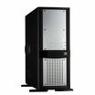
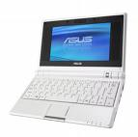


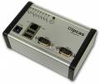
Where is GNU/Linux used?
Originally developed for 32-bit x86-based PC
Ported to other architectures, eg.
Alpha, VAX, PowerPC, IBM S/390, MIPS, IA-64
PS2, TiVo, cellphones, watches, Nokia N810, NDS, routers, NAS, GPS, …
In Servers:
Databases, Web services, mail services, Network services in general
On regular computers:
At home, at school, on the OLPC, on the EEEPC, on my Laptop…
On Workstations for professional activities:
From 3D rendering to library management including SW development of course…
In Super Computers:
Large grids and parallel computers (Research institutes, etc)
In Embedded Systems:
Network Routers, wireless access points, multimedia players, photo frames, mobile phones, remote controls, medical instruments, industrial applications, Military applications, etc

Slide 6




GNU/Linux history
The GNU (GNU’s Not UNIX) project was started in 1984 by Richard Stallman. The goal was to provide « a complete unix-compatible free software system ».
The Free Software Foundation, was founded in 1985 and is a non-profit corporation destined to promote and protect GNU Free Software worldwide. They are responsible for the GPL (General Public License)
Linux was created by Linus Torvalds in 1991. At that time the GNU kernel was not mature, and since then Linux has always been more popular than the GNU kernel
Linux was designed to be an clone of MINIX, a UNIX-like system

Slide 7

Free Software Principles
Free as in Free Speech, not as in Free Beer
Free is a subset of Open Source.
Often concatenated to talk about FOSS: Free and Open Source Software)
The 4 fundamental principles: Everybody’s free to:
Use it
Redistribute it
Modify it
Redistribute its modifications
Free software’s « inversed copyright » is called a copyleft
Free software is protected by Software licences:
BSD, GPL (v2 and v3), LGPL, Apache, Creative Commons, etc. These licences determins how « Free » the user is concerning redistribution and modifications.
http://www.gnu.org/philosophy/free-sw.html

Slide 8
GNU/Linux Distributions - Distro
The GNU/Linux community is organized in « families » called « distributions »
Debian, RedHat, Ubuntu, Suse, etc
Each distribution basically implements its own way to manage software packages, configuration, etc, so choosing a distribution is like choosing a car brand. After that you can choose the model (for example « server installation » or « workstation » or even « minimalistic system »
Every distribution uses the Linux kernel plus sometimes some custom patches: it’s the « engine »
*** BSP (Board Support Package) can be seen as a distribution***

Slide 9
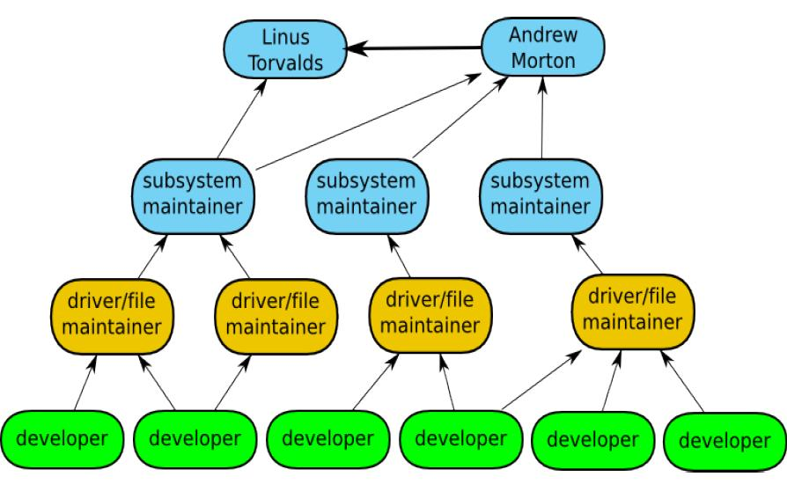
The Linux Kernel Community
Greg KH presentation at OLS

Slide 10
The General Public License (GPL)
A License determin how the code is protected and reusable. Basically, the author chooses the license and then everybody has to comply.
The GPL basis is « everything using GPLed code or binaries becomes GPL », so it’s a « viral » license
The GPL guarantees that source code can be requested if the binary is distributed.
SO if you’re customer develops software using GPL libraries it will automatically be subject to GPL so the customer will have to redistribute all his source code under the GPL! (which does not mean that he will have to do it for free)
http://www.softwarefreedom.org/resources/2008/foss-primer.html

Slide 11
The Lesser General Public License (LGPL)
The LGPL has been created to limit the virality of the GPL, by saying that « if you’re software only uses LGPL software as dynamically linked libraries, then your software can be LGPL or proprietary (or anything provided it’s not viral)
Concrete example: a multimedia player
MPlayer is GPL: every codec used must be released with source code, so you cannot protect your optimizations and IP
GStreamer is LGPL: you can develop your own codecs, and make them proprietary (you don’t have to release the sources) and then link them in the GStreamer framework to build a multimedia player.

Slide 12
How do people make money of working with Free Software?
Providing services: maintainance, hardening, development, etc
Selling solutions: Montavista, WindRiver or Microcross for example sell their Linux BSPs for a cost and deliver it with the source code.
Selling advertising space on a freely distributed software
And plenty of other innovative ideas…

Slide 13

Which Linux Distribution is better?
> 300 Linux Distributions
Slackware (one of the oldest, simple and stable distro.)
Redhat
RHEL (commercially support)
Fedora (free)
CentOS (free RHEL, based in England)
SuSe ( based in German)
Gentoo (Source code based)
Debian (one of the few called GNU/Linux)
Ubuntu (based in South Africa)
Knoppix (first LiveCD distro.)
…

Slide 14
Which Linux Distribution is better?
Ask yourself these questions
Is it going to be around in 5 yrs?
Is it going to stay on top of the latest security patches?
Is it going to release updated software promptly?
If I have problems, will the vendor talk to me?

Slide 15
Linux Shell

Slide 16
The Linux System
User commands includes executable programs and scripts
The shell interprets user commands. It is responsible for finding the commands and starting their execution. Several different shells are available. Bash is popular,
user
Application
Shell
Kernel
The kernel manages the hardware resources for the rest of the system.
Hardware
Vị trí của Shell và Kernel trong cấu trúc phân tầng hệ điều hành

Slide 17
The application space foundation: the shell console
A shell is an application which cannot be stopped and is the father of all other application processes of the system.
This Shell obeys a certain number of commands that any Linux developer or user has to know: it will be used to navigate into the filesystem, launch or kill applications, eventually logging what the application does and providing simple, serial (UART) way to control the system. It looks a lot like MS-DOS but is just a thousand times more powerful.
If the shell is killed, the kernel may still run but no applications will run anymore so the system may not be crashed but will probably be mostly inoperant.

Slide 18
Why Do I Care About The Shell?
Shell is Not Integral (built-in) Part of OS
UNIX is among the firsts to separate shells from the OS.
Compare to MS-DOS, Mac, Win95, VM/CMS
GUI is NOT Required
Default Shell Can Be Configured
chsh -s /bin/bash
/etc/passwd
Helps To Customize Environment

Slide 19
Shell Scripts
#!/bin/bash
while
true
do
cat somefile > /dev/null
echo .
done
/* */
do forever
‘PIPE < SOME FILE | hole’
say ‘.’
end

Slide 20
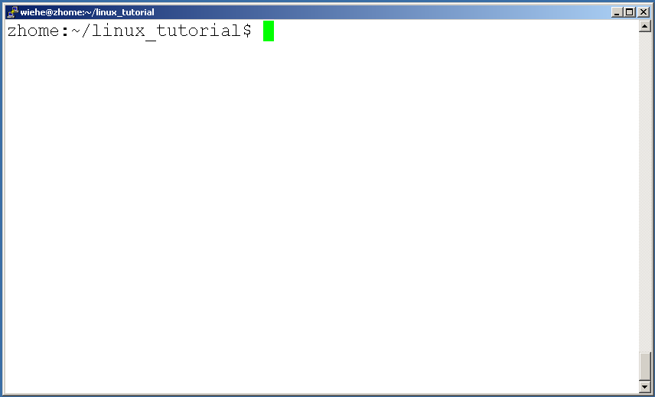
Connecting to a Unix/Linux system
Open up a terminal:
The “prompt”
The current directory (“path”)
The host

Slide 21
Linux File hierarchy & Permission

Slide 22
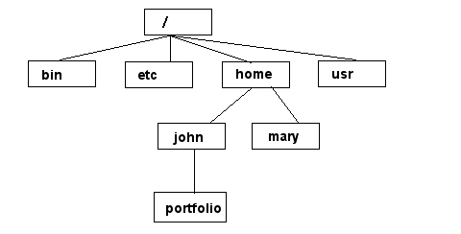
Unix/Linux File System
NOTE: Unix file names
are CASE SENSITIVE!
/home/mary/
/home/john/portfolio/
The Path

Slide 23
Permission and Ownership
Group
-rwxr--r-- 1 ssugrim staff 2648064 2008-07-03 10:26 winlab-ghost-netboot.sys
File have an owner and a permissions set
The permissions can be modified with chmod
The owner (and group) can be modified with chown
The permission are read –uuugggwww where u = user, g = group, w = world
r = read, w = write, x = execute privileges
permissions can be assigned numerically if you assume that each position is a 3 bit number, and then write the decimal equivalent
e.g. –rxwrwxrwx is equivalent to 777
Owner
Date
Name
Permission
Size

Slide 24
Linux Packages

Slide 25
Packages
Many distributions have gone to packages for distributing software, the old tar.gz system wasn’t robust/useable enough
Debian (from which Ubuntu is based) uses the dpackage system
files ending in deb are Debian packages, in contrast to rpm (Fedora/Redhat), ebuild (Gentoo)
Packages make your life simpler

Slide 26
Package tools
There are two tool suites to manage packages (actually more, but two main ones)
apt-* is a set of tools for installing software from Ubuntu’s (Canonical’s) repositories
(really any ones repositories, assuming you configured it correctly
Example:
Install an package: apt-get install <pkg-name> or aptitude install <pkg-name>
Search a package in local cache: apt-cache search <pkg-name>
Update local cache from internet repository: apt-get update
Synaptics is a GUI tool for install software on Ubuntu
dpkg-* is the “manual” installation tool suite, it knows nothing about repositories

Slide 27
Dependencies
Packages are arranged in hierarchies
Since there is much code reuse many packages depend on other packages being installed
Both tools are aware of dependencies, but they differ in how they handle them

Slide 28
Apt vs Dpkg
This biggest difference between apt and dpkg is how dependencies are handled
when apt is asked to install a package, it checks dependencies and asks if it’s ok to add all of the dependant packages as well
dpkg just complains that dependencies are not met, and then refuses to install
this can be overridden, a forced installation has many dangers

Slide 29
Why would you use dpkg then?
dpkg can force installation
some times packages you need are not in the repository
dpkg operates independent of the package hierarchy
dpkg can forcibly remove things as well
dpkg –l is the only non gui way to see a list of installed packages

Slide 30
Apt
Syntax | Description | Example(s)
apt-get install {package} | Install the new package. If package is installed then try to upgrade to latest version | apt-get install zip apt-get install lsof samba mysql-client
apt-get remove {package} | Remove/Delete an installed package except configuration files | apt-get remove zip
apt-get --purge remove {package} | Remove/Delete everything including configuration files | apt-get --purge remove mysql-server
apt-get update apt-get upgrade | Resynchronize the package index files and Upgrade the Debian Linux system including security update (Internet access required) | apt-get update apt-get upgrade
apt-get update apt-get dist-upgrade | Usually use to upgrade to Debian distribution. For example Woody to Sarge upgrade. 'dist-upgrade' in addition to performing the function of upgrade, also intelligently handles changing dependencies with new versions of packages; apt-get has a "smart" conflict resolution system, and it will attempt to upgrade the most important packages at the expense of less important ones if necessary. | apt-get update apt-get dist-upgrade

Slide 31
Basic Shell Commands

Slide 32
Accessing Documentation 1/2
Commands are generally documented using the command man.
man pages are subdivided into various sections
Example: Documentation of the man command
man man
Example: Documentation of the time command
man time
Example: Documentation of the time C library function
man 3 time
man will present the manual page of the specified entry using more or less.
In Linux, the default is less, but can be overridden
less presents a screen-full at a time. ‘spacebar’ moves forward, ‘b’ moves backward, ‘$’ moves to end, ‘q’ quits, ‘?’ helps.

Slide 33
Accessing Documentation 2/2
A few commands (such as diff, gcc, awk) are doccumented using info.
info is GNU-specific
Uses its own hypertext ‘viewer’.
arrow-keys select different links
space pages forward
‘u’ goes back “up” a hyperlink level, like “back” in browsers
Most commands have HTML references on the WWW.

Slide 34
Getting around the filesystems 2/6
Commands to navigate the directories:
pwd
ls
ls file; ls directory ; ; ls –a ; ls –l ; ls -R
cd
cd ..
cd /home/tim/projects
cd ~/projects
cd ~tim/projects
cd $HOME/projects
mkdir
rmdir
mv
mv oldfilename newfilename
mv file1 file2 file3 newtargetdirectory
cp -- syntax like mv
cp –r dir1 dir1copy
rm
push
pop
find
find . –ls
find . –type d –print
find . –type f –exec “echo” “{}” “;”
Notes:
pwd Print or list the present working directory with full path.
ls List contents of a directory.
Ex: ls, ls –l , ls –al, ls –ld, ls –R
(-rwxrwxr-x 1 juan juan 0 Sep 26 12:25 foo )
|more will list page wise
cd Change the current directory. With no arguments "cd" changes to the users home directory. (cd <directory path>)
mkdir Make a directory.
Ex: mkdir <directory name> : Makes a directory
Ex mkdir –p /www/chache/var/log will create all the directories starting from www.
mv Move or rename a file or directory.
Ex: mv <source> <destination>
cp Copy a file from one location to another.
Ex: cp file1 file2 : Copy file1 to file2
Ex: cp –R dir1 dir2 : Copy dir1 to dir2
rm Delete files (Remove files). (rm –rf <directory/file>)
rmdir Remove a directory. The directory must be empty. (rmdir <directory>)
find Find files (find <start directory> -name <file name> -print)
Ex: find /home –name readme -print
(Search for readme starting at home and output full path.) “/home" = Search starting at the home directory and proceed through all its subdirectories
"-name readme" = Search for a file named readme
"-print" = Output the full path to that file

Slide 35
Getting around the filesystems 3/6
File compression, backing up and restoring
compress Compress data.
uncompress Expand data.
cpio Can store files on tapes. to/from archives.
gzip - zip a file to a gz file.
gunzip - unzip a gz file.
tar Archives files and directories. Can store files and directories on tapes.
Ex: tar -zcvf <destination> <files/directories> - Archive copy groups of files. tar –zxvf <compressed file> to uncompress
zip – Compresses a file to a .zip file.
unzip – Uncompresses a file with .zip extension.

Slide 36
Getting around the filesystems 4/6
cat View a file
Ex: cat filename
cmp Compare two files.
cut Remove sections from each line of files.
diff Show the differences between files.
Ex: diff file1 file2 : Find differences between file1 & file2.
echo Display a line of text.

Slide 37
Getting around the filesystems 5/6
grep List all files with the specified expression. (grep pattern <filename/directorypath>) Ex: ls –l |grep sidbi : List all lines with a sidbi in them.
Ex: grep " R " : Search for R with a space on each side
sleep Delay for a specified amount of time.
sort Sort a file alphabetically.
uniq Remove duplicate lines from a sorted file.
wc Count lines, words, characters in a file. (wc –c/w/l <filename>).

Slide 38
Getting around the filesystems 6/6
File viewing and editing
emacs Full screen editor.
pico Simple text editor.
vi Editor with a command mode and text mode. Starts in command mode.
gedit GUI Text Editor
tail Look at the last 10 lines of a file.
Ex: tail –f <filename> ,
Ex: tail -100 <filename>
head Look at the first 10 lines of a file. (head <filename>)

Slide 39
Redirecting
You can redirect the output of a command to a file.
For example: ls -l > filesList.txt
The '>' directs the output to the file.

Slide 40
Pipe
Pipes let you use the output of a program as the input of another one!
Here are a few samples: ls -l | less ps aux | grep firefox | less

Slide 41
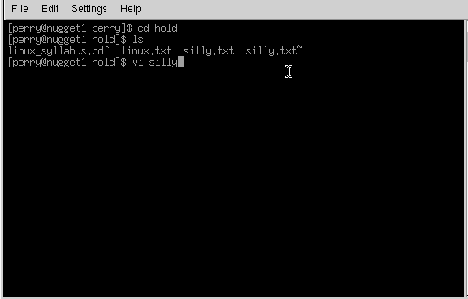
The VI Editor 1/2
Opens from terminal window
Notes:
From the command line, type vi blah
The editor will appear on-screen, with a tilde, ~, on evey line, and at the bottom of the screen it says "blah" [new file]. If you want to put anything into this file, you have to put vi into insert mode. Do this by typing the letter 'i' on its own. "-- INSERT --" appears on the bottom of the screen. Now you can type in anything you want. Try typing "Hello", and then on a new line "World". Now try going back up to the line above, using the cursor keys and try to delete Hello. You wont be able to. When you give a Carraige Return (Press Enter in other words), the text on that line becomes static. If you want to delete it, heres how.
Press your Esc button on the top left of the keyboard, and the "-- INSERT --" at the base dissapears. Vi is ready to accept a new command. The only thing here is that vi will only delete what is in front of the cursor, let me show you. Bring the cursor to the start of Hello, and press the x key once. Now only 'ello' remains. This doesnt really make any sense, so we'll delete the line altogether. Press 'd' twice in quick sucession. Now we have the word 'World' on its own. Press 'i' and insert "Hello" again. This time, leave the text in insert mode. Press the "Insert" key on your keyboard, its above the cursor keys. The "-- INSERT --" at the base of the screen has been replaced with "-- REPLACE --". Now type the word "Nurse" over the existing "World". Press Esc again to return to the ready mode.
Vi has a search tool too, which I find indispensable. From the ready mode, type in a slash, /, and input the text you want to look for. Remember, since Linux is case sensitive, looking for "money" is not the same as looking for "Money".
Well, what about saving the file, or quitting without saving? What about just quitting? Its easy. From the ready mode, type in ":w" to write the file ... you already supplied the file name when you typed 'vi blah' earlier. The editor will return this on the status line : "blah" [New File] 1 line, 12 characters written. Lets quit out of it altogether. Type in ":q“or :quit!. You have been returned to the command prompt. There was an easier way of doing that ... from the ready mode in the editor, you could have just typed in, in cap:itals, "ZZ" ... this saves the file and quits. If you had wanted to quit without saving the changes, you could have just typed in ":q!", and nothing would have saved ... blah wouldn't have existed.

Slide 42
Vi
2 modes
Input mode
ESC to back to cmd mode
Command mode
Cursor movement
h (left), j (down), k (up), l (right)
^f (page down)
^b (page up)
^ (first char.)
$ (last char.)
G (bottom page)
:1 (goto first line)
Swtch to input mode
a (append)
i (insert)
o (insert line after
O (insert line before)
Delete
dd (delete a line)
d10d (delete 10 lines)
d$ (delete till end of line)
dG (delete till end of file)
x (current char.)
Paste
p (paste after)
P (paste before)
Undo
u
Search
/
Save/Quit
:w (write)
:q (quit)
:wq (write and quit)
:q! (give up changes)

Slide 43
Ubuntu Introduction

Slide 44
What is Ubuntu?
Ubuntu (pronounced oo-BOON-to) is a Linux-based operating system that is open sourced (free)
Ubuntu is an African concept meaning “humanity towards others”
Ubuntu is sponsored by Canonical Ltd. owned by South African billionaire Mark Shuttlewort – the Ubuntu creator

Slide 45
Why Ubuntu?
Ubuntu has strong focus on usability and ease of installation
Ubuntu comes with lots of programs preinstalled (OpenOffice, Firefox web-browser, games, tweak tools)
Ubuntu is absolutely free

Slide 46
System requirments
Current version – 8.10 Intrepid Ibex
Next version – 9.04 Jaunty Jackalope
256 Mb RAM
3 Gb hard drive space
Can be dual booted with currents OS or used from a live CD in a fully efficient mode

Slide 47
Summary
Pro:
Open source (and free)
Every 6 months upgrade available
Compatible with MS programs
Many add-ons available
No key codes, activation, registration
High performance. No more slow PC!
New generation of desktop themes
Long term excellent no-wait support
No viruses almost
Fast release cycle

Slide 48
Summary
Con’s:
Drivers for peripherals are not always available
PC games are not compatible
No non-free video and audio codec's preinstalled (mp3,mp4,divx,ffdshow)
Not all PC programs are compatible

Slide 49
How to get Ubuntu
The three ways to acquire:
Download from the Internet (www.ubuntu.com or local mirror)
Get a CD with Ubuntu absolutely free directly to you post-box (www.shipit.ubuntu.com)
Ask me or refer to the ASDP chair (you’ll be pleasantly provided with a free copy of Ubuntu). No beer even:)

Slide 50
Ubuntu alternatives
Ubuntu (with Gnome)
Kubuntu (with KDE)
Xubuntu (with Xfce) for slower PC’s
Edubuntu (for educational purposes)
Gobuntu
Goobuntu (directly from Google)

Slide 51
Software Repositories Ubuntu
main
Core install of Ubuntu
Fully supported by Ubuntu
Freely redistributable and unencumbered, but may contain binaries.

Slide 52
Software Repositories cont.
restricted
Commonly used software, but is not licensed as completely free.
Supported by Ubuntu as best as possible.
Includes binary drivers for specific hardware.
Open source versions used first.

Slide 53
Software Repositories cont.
universe
Contains remaining open source software that may be available under “less open licenses.”
Built against libraries and tools in “main”, thus it should install and be stable.
No guarantee of regular updates, but they are provided as made available.

Slide 54
Software Repositories cont.
multiverse
Contains software that is “not free.”
You must determine if you meet licensing requirements.
Unsupported and updates/upgrades are not provided.
Use “at your own risk.”

Slide 55
Additional Repositories
Backports
See http://www.backports.org/
Be careful with these. Newer software that is “backported” to run on older versions of Ubuntu (or Debian...).
Can cause problems if you wish to do a distribution upgrade.

Slide 56
Specifying Repositories
/etc/apt/sources.list
We'll hand edit this file. If you use a GUI, then Synaptic can do this for you.
This file contains a number of additional items...
Understanding the configuration is critical to understanding your config.

Slide 57
Q & A

Slide 58
Recap
Understanding about Unix, Linux, OSS, know how the community work
Common License in OSS and Linux Distro
Basic understanding about Linux file system and file permission
Know how to operate Linux Shell, basic commands in Shell, how to manipulate Linux Packages
Basic concepts about Linux Ubuntu

Slide 59
Thank You!

